Slide 1
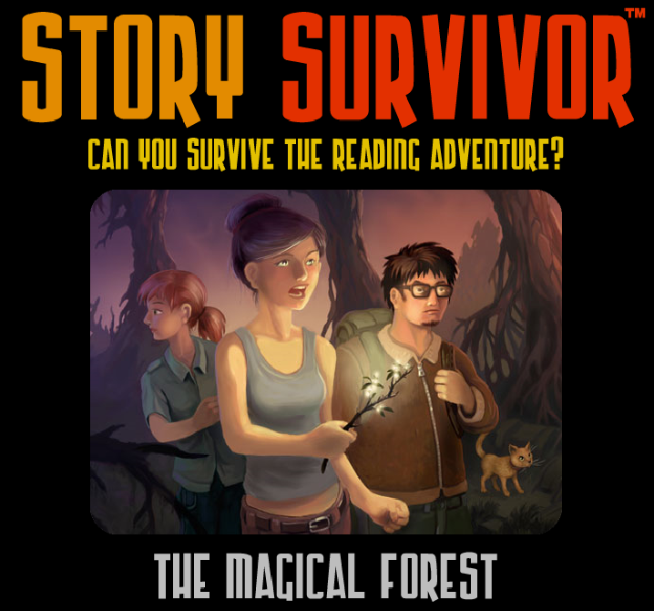

Slide 2
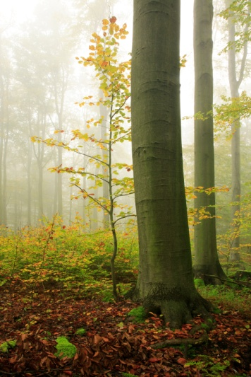
Overview:
You, two friends, and your kitten, find yourselves in a spooky forest, not knowing how to make it back to the safety of the rural park in which you were having a picnic. Exploring the forest is the only option when you learn you can’t go back the way you came. But, will you make it out alive?
Make your choices wisely or you will surely perish.

Slide 3
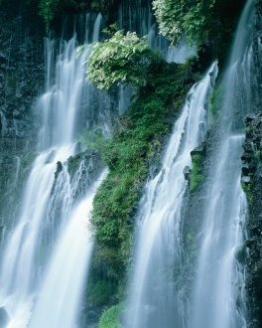
A-The path in the direction of The Deadlands. B-The path in the direction of The Cliffs. C- The path in the of Troll Hollow.
“Check out that waterfall!” says your friend Herbie. He points to a cascading wall of liquid that is nearly hidden from view on the edge of a rural park. You and your other friend, Rachel, halt your picnic—galloping over to the plants covering the gushing water and brush them aside.
“Wow!” you say. “I see something behind the water.”
“Huh?” says Herbie as your kitten, Dinkins, wraps her body around your legs playfully. “Oh, now I see it too. It looks like a tunnel. Let’s see what’s on the other side.”
Without pause, you and your friends plus one cat step into the sheet of water and through a rock tunnel to the area beyond. Once there, you try to turn back, but the tunnel has seemingly vanished. “I guess we’ll have to find another way out,” you say as your eyes fall upon an old wooden sign with three arrows—each pointing to a different pathway: The Deadlands, Troll Hollow, and The Cliffs. “Which path should we take?”

Slide 4
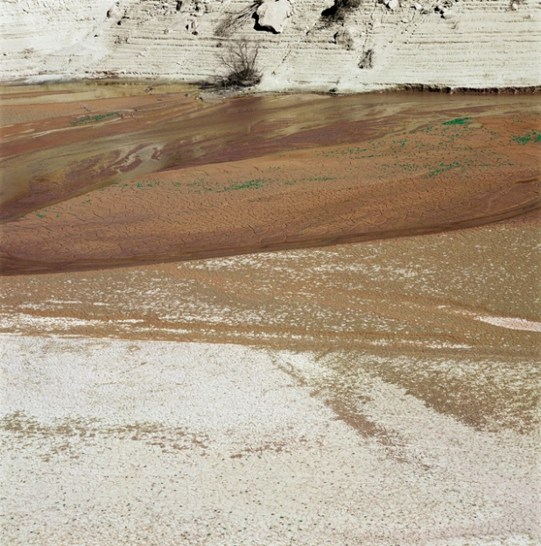
Try Again
You shoot your friends a confident gaze and then bob your head up and down. “This will be a breeze, Rachel,” you say. “I can easily jump over this quicksand river.”
Herbie and Rachel exchange worried glances. “Are you certain?” asks Herbie. He uses his index finger to push his glasses further up on the brim of his nose as he speaks. “Even if you make the jump, I’m not sure I’ll be able to leap that far.”
“Stop being a baby,” you say right before you run and use the spring in your legs to jump with all the might you possess—Dinkins snuggled in your arms. Seconds later, your friends are covered in muck. The splash you made when you tumbled into the river of quicksand ended up on their persons. They both fall into the sea of muck as well while trying to rescue you.

Slide 5
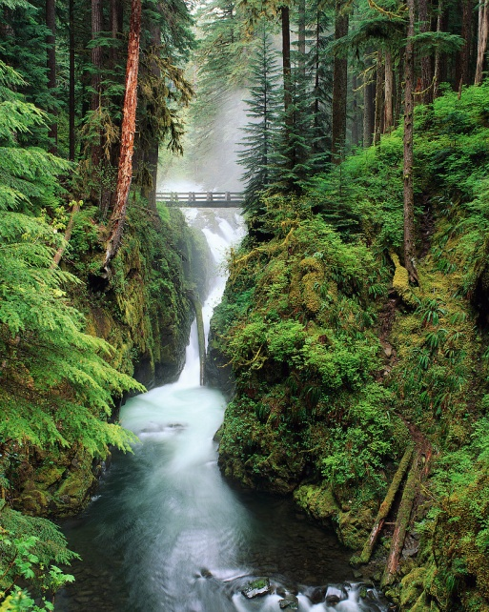
Exhausted from hours spent walking in the forest and your battle with monstrous vines, you have clearly lost your mind. “Swim for it!” you shout as you dive into the freezing cold water and float down the stream. Rachel and Herbie shrug before jumping in just after Dinkins too takes the dive. Moments later your bodies crash against jagged rocks sticking up out of the river rapids.
Try Again

Slide 6
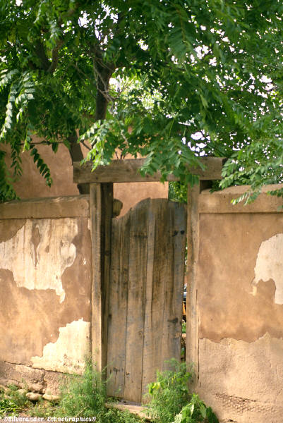
Try Again
“Yes,” you say loudly, “We would like entrance!”
Suddenly, another ghastly troll pokes his head up and over the tall gates and laughs. “I bet you would,” he says. “
But, we don’t let just anyone into our hidden village for free,” says the first troll. “So, what do you offer?”
Quickly, you whisper your plan to Rachel and Herbie. “We have lots of gold in Herbie’s backpack,” you say as you hold up the canvas bag. The trolls start salivating over the thought of the precious metal and open the gates at once. As you walk through the entrance to Troll Hollow, you are amazed at the secret bustling town of trolls that exists in this forest. Though, your awe doesn’t last for long as you’re soon surrounded by a gang of heavily-armored trolls holding sharp metal swords.
“Where’s the gold?” one of them demands. Realizing that you were lying, they put a swift end to all of you.

Slide 7
Try Again
Realizing that the vines are too strong to be pulled apart by hand, you wonder if they can feel pain just like any kind of animal. As they snake around your arms and legs—holding you more tightly by the second—you know you won’t have long before the life is squeezed out of you entirely. “Try biting the vines!” you scream just before you sink your teeth into their tough bark.
Though, all you receive for your efforts is chipped teeth and a demise that felt as though a pack of furious elephants had stampeded over your body.

Slide 8
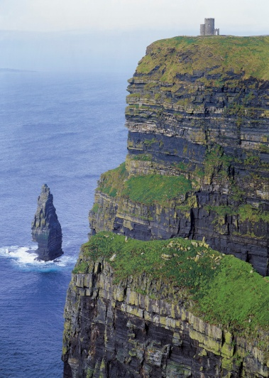
Try Again
“Jump!” you shout.
Rachel screams, “We will die if we fall!”
“Totally” adds Herbie. “It’ll be Splat-City!”
You look down and see the incredible distance you will drop if you jump and the jagged trees into which you would fall. Though, as a vicious bird pecks your left ear—this time drawing blood—you can’t think of any other option and are ready to take your chances. “Fine! Stay up here and be pecked to death if you want! I’m getting out of here!”
With that, you and Dinkins jump into the air, through the flock of birds, and begin your descent to the ground. Your friends follow suit soon thereafter. Herbie’s guess was correct. Splat-City, indeed.

Slide 9
A-Beg and plead with the gatekeeper to open the gates of Troll Hollow. B-Threaten the gatekeeper with his life if he doesn’t open the gates to Troll Hollow. C-Lie to the gatekeeper—telling him you have gold to trade for entrance. Go Back
You and your friends make the decision to follow the path that leads to Troll Hollow, reasoning that it might be fun to meet some real trolls. You all walk down the dirt trail in the lush forest around you for what seems like hours—with no end in sight. Several times you think you hear voices and whispers in the trees to the sides of the path. You wonder if you might be going crazy. But, you know that can’t be the case when Herbie and Rachel say they hear the sounds too.
“What kind of forest is this?” asks Rachel just as you put a hand out to stop her from walking further forward.
“The kind that has giant wooden gates, it seems,” you say—pointing at the huge structure blocking the path. Dinkins jumps into your arms as you watch an ugly, green-skinned, beast show himself over the top of the gates.
“What do you want?” asks the hideous troll. “Would you like entrance to Troll Hollow, by chance?”

Slide 10
Try Again
“I never liked this cat, anyway,” you say as you hand over the little ball of fur to the troll leader. Almost at once, Dinkins realizes what is happening and becomes angrier than you have ever seen her.
“Meow!” screams Dinkins loudly as she jumps from the arms of the stinky troll and lunges at you, Herbie, and Rachel. The claws of Dinkins the kitten are certainly an end you didn’t exactly see coming. Afterward, she ends up as a feline and blueberry pie that the trolls enjoy.

Slide 11
Try Again
“Hey,” says Rachel, “remember our performance last year at the school talent show?”
“That’s right,” agrees Herbie. “Let’s perform it here.”
“Well,” barks the troll leader. “What will it be?”
You tell the oafish troll that you and your friends will gladly perform a song and dance number to entertain all of the residents of Troll Hollow. He likes the sound of that and lets you rest for a few hours before you go on stage. At the appointed time, you’re directed to a large wooden platform in the middle of the troll city where hundreds of tall, ugly trolls are losing their patience in the audience.
Surprisingly, the troll leader hands you a working microphone. But, as you start to sing with Rachel and Herbie as backup dancers, the trolls are unimpressed. They swarm the stage—stampeding all of you. “Meow!” screams Dinkins before she is flattened.

Slide 12
Try Again
Talking it over with Rachel and Herbie, you decide that working in a troll factory can’t be that horrible. The trolls are honorable and keep their word. They give you a lengthy time to rest, serve you pickled lemonade, and tell you how to get out of the forest and back to your world. Then, after you have received your end of the bargain, they throw each of you in a sweatshop and force you to sew troll clothing for the next forty-eight hours straight.
You and your friends die of exhaustion.

Slide 13
A-Try biting them with your teeth. B-Try pulling them off your body with your hands. C-Try setting them on fire using Herbie’s lighter. Go Back
Glancing upward while trying to think of a way to cross the river of quicksand, you notice the heavy vines that dangle from the treetops. They don’t quite reach the ground. Even so, you wonder if they could support your weight if you climb the trees. “It’s worth a shot,” you say after explaining the idea to Rachel and Herbie.
Climbing one of the trees swiftly, you step out onto a branch and grab hold of one of the vines. You wrap it around your hand tightly and then swing from one tree to the next. Your friends follow your lead and are soon safely on the other side of the quicksand too—Dinkins traveling in Herbie’s backpack. “That was awesome,” says Rachel. Suddenly, the vines come to life and wrap around your bodies—pulling you to the ground.
“They’re alive!” shrieks Herbie.
“How do we break free?” asks Rachel. The vines keep tightening around your hands, legs, and torsos.

Slide 14
Try Again
“What do you say we make a raft out of these fallen tree branches and ride the river to safety?” you say.
“Great idea,” says Rachel and Herbie in unison. “Okay,” you say. “Let’s collect all the wood on the ground we can find. Then, we’ll start building the raft.”
You and your friends start gathering every twig or stick you can find. However, this does not please the local beaver population. They surround you after a few minutes. “Those are our sticks!” they shout.
“We just need to borrow…” Rachel starts to say.
“Attack!” yells one of the beavers and before Rachel can fully explain, the giant front teeth of the beavers clamp down.

Slide 15
A-Let him eat Dinkins. B-Offer to perform a show to entertain the trolls. C-Agree to work off your debt in the troll factory. Go Back
“Please kind troll,” you plead in a tiny voice. “We have just walked through the woods for hours. Our feet are sore and aching. We’ll give you anything if you will let us rest and then tell us how to make it back to the park.”
Another troll, giggling with delight, pops his head over the high gates protecting his city. “Anything?” he says in between bouts of subtle laughter.
You nod in agreement.
“Open the gates!” yells the repulsive troll. You hear the sound of heavy machinery as the gates slowly hinge inward. Out stumbles what seems to be a small army of solider trolls—ready for combat. They hold long swords and seem thirsty for blood. The leader troll walks up to you, Rachel, Herbie, and Dinkins. “We’ll give you what you want. But, in exchange, you either have to work it off in the factory, entertain us with a show, or let us eat your pet kitten. They are a delicacy in our world.”

Slide 16
Try Again
As the obese ogre charges, you and your friends seem to arrive at the same conclusion: the only way out of this situation is to use the hang-glider as it was intended. Lifting it off the ground, you all grab onto the bar and run with all you have toward the side of the cliff. The ogre takes a swipe at you with his club—missing you by mere inches as you soar through the air. “Ha! How do you like that?” you shriek back at the angry beast. He slams his club to the ground and pulls a tiny remote control device from his belt.
“Not as much as I like this,” he mumbles before using a thick thumb to press the circular red button. Luckily, you never feel a thing as the hang-glider explodes in mid-air. “Looks like it was a good investment to have the forest elves rig that self-destruct mechanism for me. Worked like a charm.” The ogre picks up his club and smiles.

Slide 17
A-Try placing a fallen tree trunk over the river of quicksand as a bridge. B-Try running and jumping over the quicksand. C-Climb the nearby trees and try swinging over the quicksand river with vines. Go Back
Talking it over hurriedly with your pals, you all decide that although the path leads to a spooky-sounding place, The Deadlands probably won’t be as bad as the name implies. So, you start down that path. Initially, the hour or so you spend walking is along what seems like a normal dirt trail in any forest setting. Though, after a while you walk along more and more dead plant life until it seems that every tree and shrub is shriveled and decaying. Even spookier is the fact that the light seems to fade as well. When it’s nearly dark, you notice something sparkle on the ground. “It’s a small twig with glowing flowers,” you say. You pick up the stick to help light your way.
After a little more walking, your party comes to what looks like a giant pit of murky sand that stretches across the forest floor like a river. “I think this is quicksand,” says Rachel. “We will have to find a way to cross over. It stretches as far as I can see in both directions.”

Slide 18
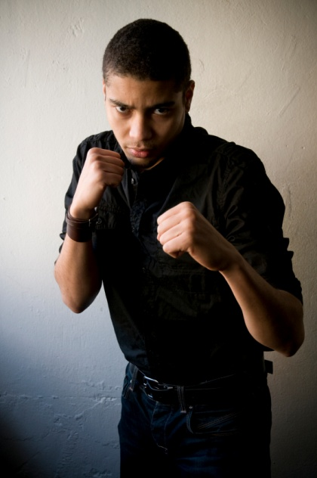
Try Again
“Oh, you want a fight?” you say—jutting your fists into the air. The ogre can’t help himself. He doubles over in laughter at the sight of your puny balled-up digits.
“That’s the funniest display I have seen in years,” says the ogre before he uses his club like an expert surgeon on you all. “I’m going to have to tell that one to my family over dinner. They will all surely get a chuckle.”

Slide 19
A-Swim for it! B-Make a rickety raft out of fallen sticks, logs, and branches to ride down the river. C-Walk along the muddy river shore to safety. Go Back
You try to pull the vines from your legs, but they won’t budge. You think about biting them, but can tell the bark is way too tough. It’s then that an idea hits you. “They’re incredibly dry—just like deadwood! Quick, Herbie!” you yell as you feel the increasing pressure on your abdomen and legs. “Reach into your backpack and throw your lighter to me!”
Herbie, close to passing out himself, slowly does as commanded and tosses the shiny metallic item to you. With a snap and a spark, you have fire and set the vines near you ablaze. They burn as though they had been soaked in gasoline and release their grip on all of you.
You then sprint away, running at least twenty minutes down the pathway, until you come to a river at least thirty feet wide with strong rapids. “This river is our ticket out of this place,” you say. “It will have to flow back to the docks at the park We need a way to use it for travel.”

Slide 20
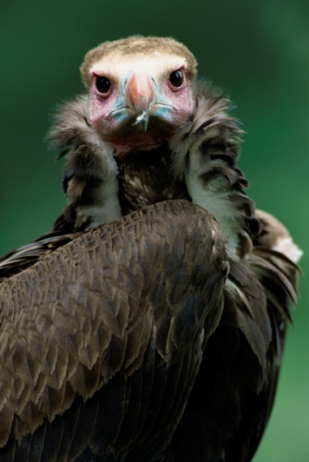
Try Again
“Hurry!” you shout as the birds start attacking your foursome with fervor. “Climb the cliffs as fast as you are able!” You all start to scramble up the limestone and granite walls. At first, it seems like you’ll escape the wrath of the birds. With their heavy bodies, they can’t fly very accurately or quickly. But, after a few minutes, you tire and lose your footing. Falling backward, you slam into Rachel and Herbie—knocking all of you down to a painful end at the hands of gravity.

Slide 21
A-Grab onto the glider and try to soar off the top of the mountain. B-Fight the ogre with your bare hands. C-Destroy the glider in an effort to distract the ugly ogre. Go Back
Thinking quickly, you reason that the only way to get rid of the snake is to cut off its head. “You know what to do,” you whisper into Dinkins’ ear before throwing the kitten full force at the biggest of the birds. Dinkins goes right to work on the bird king with her claws.
“Ouch! That stings!” screams the large bird. He starts to fall just as Dinkins jumps back into your arms. Without a leader, the other birds quickly fly way.
Trekking cautiously along the cliffs, you finally make it to a plateau atop a mountain. You can now see for miles in any direction. The sun is setting as you set your eyes on what appears to be a hang-glider made of many tree branches and cloth. “We could use this thing to get out of here!” says Herbie. He reaches to touch the contraption.
“Don’t even think about it!” says a blubbery ogre. You all spin around in surprise. “That is my transportation!” He pulls a spiked club from his side and comes at you.

Slide 22
Try Again
“Burn it,” you say to Herbie while nodding at the hang-glider. Herbie reaches into his backpack and produces a silver-plated butane lighter he had used earlier to start a small campfire at the park. He holds the flame up to the cloth and stares down the ogre.
“Move and I torch your toy,” Herbie says defiantly.
The ogre looks at Herbie quizzically, spits a bluish-red gob of pus on the ground, and then chucks his spiky club directly at him. It hits Herbie square in the head— breaking his glasses into pieces as he falls to the ground without as much as a whimper. His lighter extinguishes, releases from his hand, and skids along the dirt. Like deer in headlights, you, Rachel, and Dinkins freeze as the ogre brings about your end as well.

Slide 23
Try Again
The only way you can think to get yourself out of this horrible situation is to use every ounce of strength left in your body to rip yourself free from the vines. The hold the vines have on you is intense—much like what you imagine a python is capable of doing. You pull and you pull, but are unable to budge the strong plant life. You lose consciousness while watching your friends and your cat wrestle with the vines as well.

Slide 24
Try Again
“Of course we want inside the gates!” you yell fiercely. “I mean, do you think we would be standing out here if we didn’t want you to open them? What are you, a moron or something? Open them up or my friends and I will be forced to take out the trash once we’re inside.”
Another troll joins the one already at the top of the gates. They both growl at you and narrow their eyes.
“Oh yeah,” you say sarcastically, “I almost forgot. In case you were wondering, you trolls are the trash!”
“What are you doing?” screams Rachel. “You’re going to get us killed!” shouts Herbie.
“Meow!” chirps Dinkins.
The trolls open the gates. But, neither you nor your friends have the chance to step inside. Instead, out come at least twenty filthy trolls—armed to the teeth with axes and swords. Perhaps you shouldn’t have angered them.

Slide 25
You Survived
Wisely, you decide not to chance entering the wild rapids of the river. You knew right away that swimming was out of the question. The water temperature would be far too icy. You had thought about building a quick raft out of the branches and sticks resting on the ground. But, you’re no expert at construction. So, you instead make up your mind to simply walk along the shore in the direction the water flows. Your friends don’t like this idea because their feet are very sore. “It’s our only choice,” you say. “That is, unless you want to die here.”
After a couple of hours hobbling painfully along the muddy shore of the river, you come to the docks at the park just as you anticipated. Your families are waiting with open arms. They were worried sick that you were lost and wouldn’t return. You embrace your loved ones excitedly—the happiest you’ve ever been to see them.

Slide 26
Try Again
“Help me move this old tree trunk,” you say—enlisting the assistance of Herbie and Rachel.
“Meow,” says Dinkins as he watches you struggle with the ancient piece of deadwood. You three lift the trunk and topple it over the river of quicksand—creating what seems to be a sturdy makeshift bridge.
“Let’s go,” you say as you begin skulking across its surface. However, you didn’t think about telling Rachel and Herbie to wait until you were all the way across before they began walking on the trunk as well. As they do so, the trunk rolls unexpectedly—causing you all to fall in the quicksand.
“Dinkins!” you yell. “Drag a branch or something over here to pull us out!” But, Dinkins isn’t the brightest bulb on the holiday tree. She simply dives into the quicksand to be by your side. You wish you had a smarter pet.

Slide 27
A-Jump off the side of the cliffs. B-Climb up the cliff as fast as you can in an effort to escape the hungry flock of birds. C-Find a way to take out the bird leader. Go Back
“I bet if we head to The Cliffs, we’ll climb high enough to be able to survey the area below and see the way out of here,” says Herbie. You can’t really argue with this idea as you are at a loss for a better one. So, you and your friends begin walking down a path that soon rises dramatically in elevation. You cradle Dinkins in the crook of your arm while you slowly creep along a narrow cliff.
“Don’t look down!” shouts Rachel.
“Or up!” yells Herbie as you all spot a flock of rather large birds coming straight for you. They’re about the size of turkeys just before a Thanksgiving Day slaughter. Their feathers are wrinkled and dirty.
“Well, what do we have here?” says the biggest of the bird flock. “Looks like dinner will be early today, my friends.” The birds chirp and cackle in agreement. It sounds like they’re laughing at you. Quickly, the clatter subsides as the birds start violently pecking at all of you.

